Slide 1

Deontological Theories – Kant and the Categorical Imperative

Slide 2


Deontological (Duty-Based Approaches)
Actions are inherently good or bad.
Help the less fortunate.
Steal.
Notes:
https://www.iemoji.com/view/emoji/56/smileys-people/thumbs-up
https://www.iemoji.com/view/emoji/57/smileys-people/thumbs-down

Slide 3
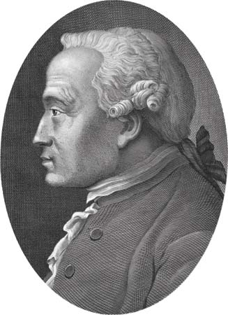
Kant’s Categorical Imperative
Act always on the principle that ensures that all individuals will be treated as ends in themselves and never as merely a means to an end.
Act always on the principle that you would be willing to have be universally binding, without exception, on everyone.

Slide 4
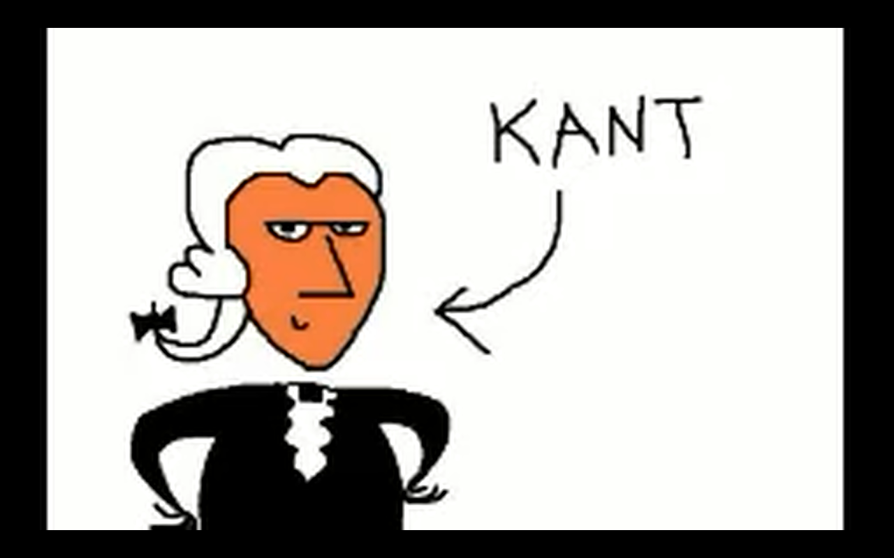
http://www.youtube.com/watch?v=xwOCmJevigw

Slide 5
Problems with the Categorical Imperative
Suppose we have the two rules.
Tell the truth.
Keep your promises.
You are part of the marketing department of a cool tech company. You have signed an employment agreement to protect your company’s trade secrets. The organizer of a trade show invites you to be on a panel showcasing upcoming products. Companies typically fall all over each other to get such invitations. Yet you know that your new product has a critical flaw, known only to company insiders. Should you:
Accept the invitation and tell the truth about your product.
Accept the invitation and misrepresent the quality of your product.
Tell the organizer that you don’t feel comfortable talking about your product.

Slide 6
The Bottom Line
No single ethical theory is a magic bullet.
Many real life situations are complex.
But these theories can help guide you as you think about what your personal answer is to the question:
What is right?

